Slide 1
Algorithm

Slide 2
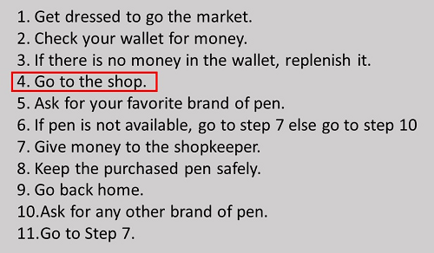
The algorithm for going to the market to purchase a pen.

Slide 3
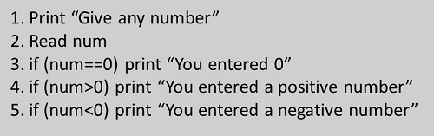

Slide 5
Algorithm to find the sum of two numbers
Algorithm
Step-1 Start
Step-2 Input first numbers say A
Step-3 Input second number say B
Step-4 SUM = A + B
Step-5 Display SUM
Step-6 Stop

Slide 6
Algorithm & Flowchart to find Area and Perimeter of Circle
R : Radius of Circle, AREA : Area of Circle , PERIMETER : Perimeter of Circle
Algorithm
Step-1 Start
Step-2 Input Radius of Circle say R
Step-3 Area = 22.0/7.0 x R x R
Step-4 PERIMETER = 2 x 22.0/7.0 x R
Step-5 Display AREA, PERIMETER
Step-6 Stop

Slide 7
Algorithm to Swap Two Numbers using Temporary Variable
Input Two Numbers Say NUM1,NUM2
Display Before Swap Values NUM1, NUM2
TEMP = NUM1
NUM1 = NUM2
NUM2 = TEMP
Display After Swap Values NUM1,NUM

Slide 8
Algorithm to find the largest of three numbers
Read three numbers say num1,num2, num3
if num1>num2 then go to step-4
IF num2>num3 THEN
print num2 is largest
ELSE
print num3 is largest
ENDIF GO TO Step-5
4. IF num1>num3 THEN
print num1 is largest
ELSE
print num3 is largest
ENDIF
5. Stop

